Slide 1
Academic Integrity Assurance Software
KEY-LOGGER PROJECT
Presented By:
Arundathi K - Jeppiaar Institute of Technology- Artificial Intelligence and Data Science

Slide 2
OUTLINE
Problem Statement
Proposed System/Solution
System Development Approach
Algorithm & Deployment
Result (Output Image)
Conclusion
Future Scope
References

Slide 3
Problem Statement
Create an educational software that logs keystrokes during online assessments to prevent cheating and ensure academic integrity.

Slide 4
Proposed Solution
A keystroke logging feature can be integrated into an educational software to monitor and record the keystrokes entered by students during online assessments. This functionality can help prevent cheating and uphold academic integrity by providing educators with insight into students' typing behaviors and identifying any suspicious activities.
The educational software should be designed to run discreetly in the background during assessment sessions, capturing all keystrokes inputted by students. It should be configured to exclude sensitive information such as passwords and only log keystrokes while the student is actively participating in the assessment.
By incorporating a keystroke logging functionality into the educational software, educators can have greater confidence in the integrity of online assessments and ensure that students are evaluated fairly based on their own knowledge and abilities.

Slide 5
System Approach
1. Development: Tkinter was utilized for GUI development, pynput was integrated for keystroke logging, and file management was implemented for storing logs in both text and JSON formats.
2. Security & Deployment: Privacy was ensured by excluding sensitive data, encryption was applied, and thorough testing was conducted before deploying the software. Clear installation instructions and technical support were provided to users.

Slide 6
Algorithm & Deployment
Algorithm:
1. Initialized global variables to store keystrokes and manage logging.
2. Specified file paths for storing logs, creating the directory if it didn't exist.
3. Defined functions to generate text and JSON log files, capturing keystrokes using pynput.
Deployment:
1. Ensured the necessary libraries (tkinter, pynput) were installed.
2. Modified file paths and directory settings as per deployment environment.
3. Packaged the script into an executable or distributed the Python script along with installation instructions.

Slide 7
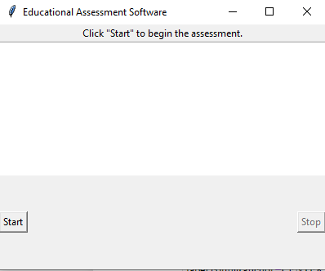
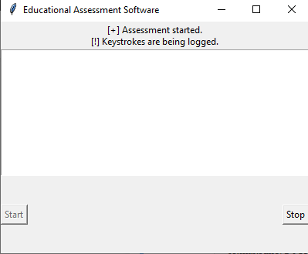
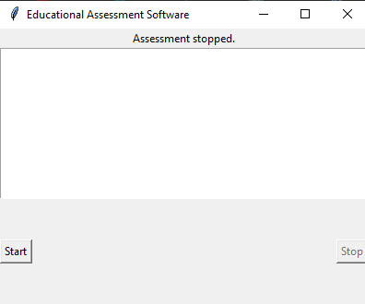
Result

Slide 8
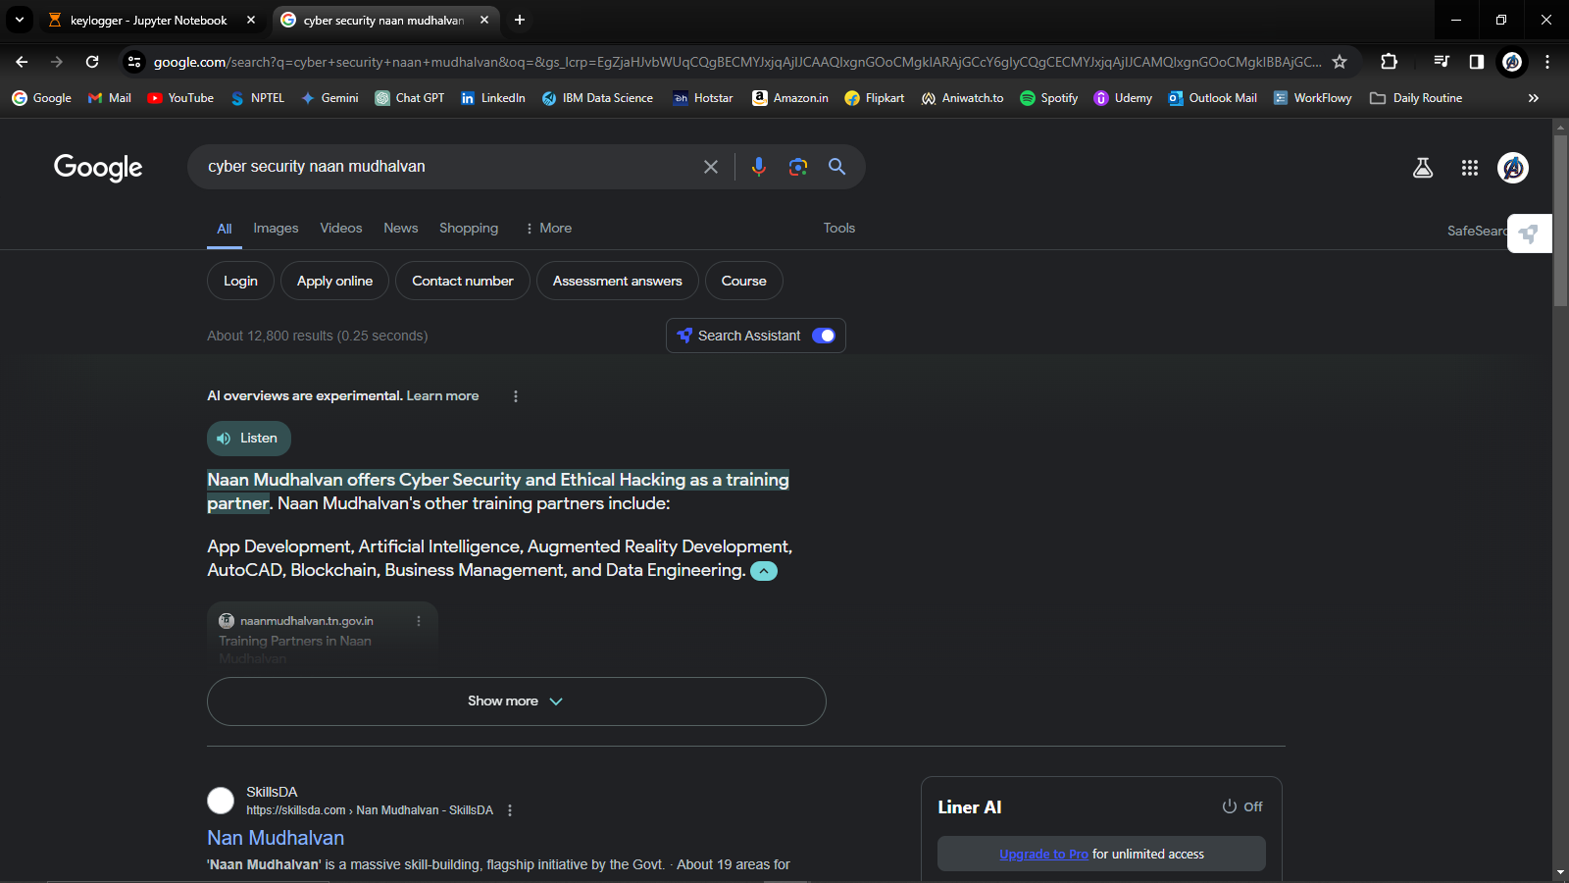

Slide 9
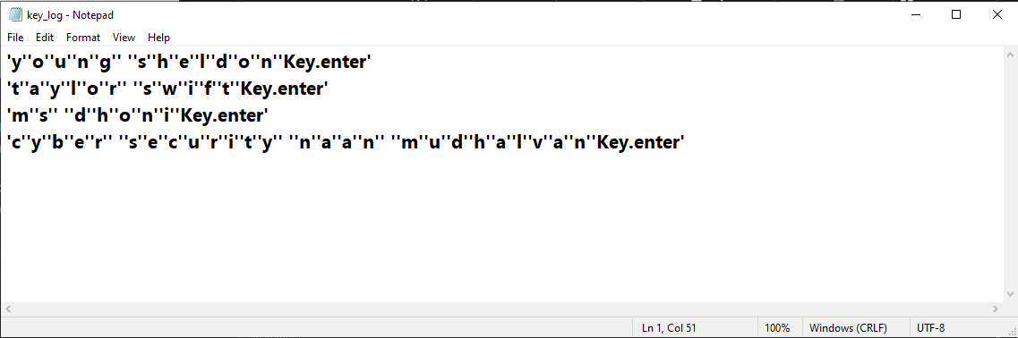
Present the results of the machine learning model in terms of its accuracy and effectiveness in predicting bike counts. Include visualizations and comparisons between predicted and actual counts to highlight the model's performance.

Slide 10
Conclusion
In conclusion, the educational assessment software was successfully developed to log keystrokes during online assessments, ensuring academic integrity. By utilizing tkinter for GUI development and integrating pynput for keystroke logging, along with implementing security measures such as excluding sensitive data and applying encryption, the software provides a robust solution for educational institutions. With clear deployment instructions and technical support, the software is ready to be deployed and used effectively to maintain academic integrity during online assessments.

Slide 11
Future scope
To ensure the security and privacy of students' data, the software should include robust measures to protect against unauthorized access and securely store the logged keystrokes. Encryption techniques can be employed to safeguard the data and prevent unauthorized viewing or tampering.
Additionally, the software can feature customizable settings to adjust the logging behavior based on specific assessment requirements. For example, educators may choose to enable or disable the keystroke logging feature for different types of assessments or specify certain keystrokes to be ignored during logging.

Slide 12
References
1. pynput Documentation → ( https://pynput.readthedocs.io/en/latest/ )
2. PyKeylogger →( https://github.com/amoffat/pykeylogger )
3. Keystroke logging with Python → ( https://nitratine.net/blog/post/simple-keystroke-logging-application-in-python/ )

Slide 13
THANK YOU

